Slide 1





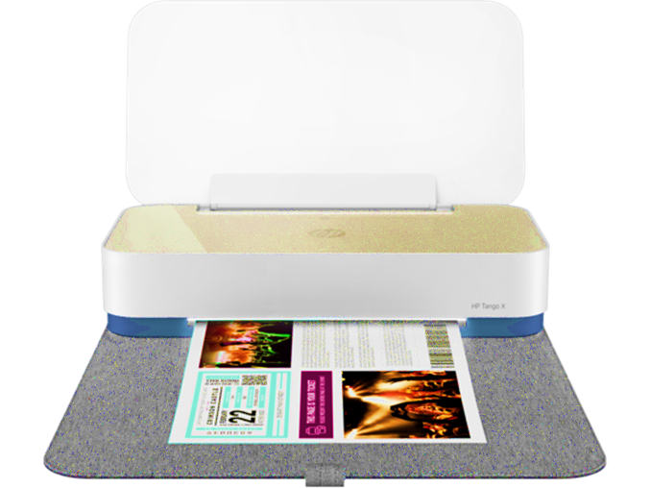
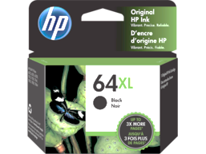

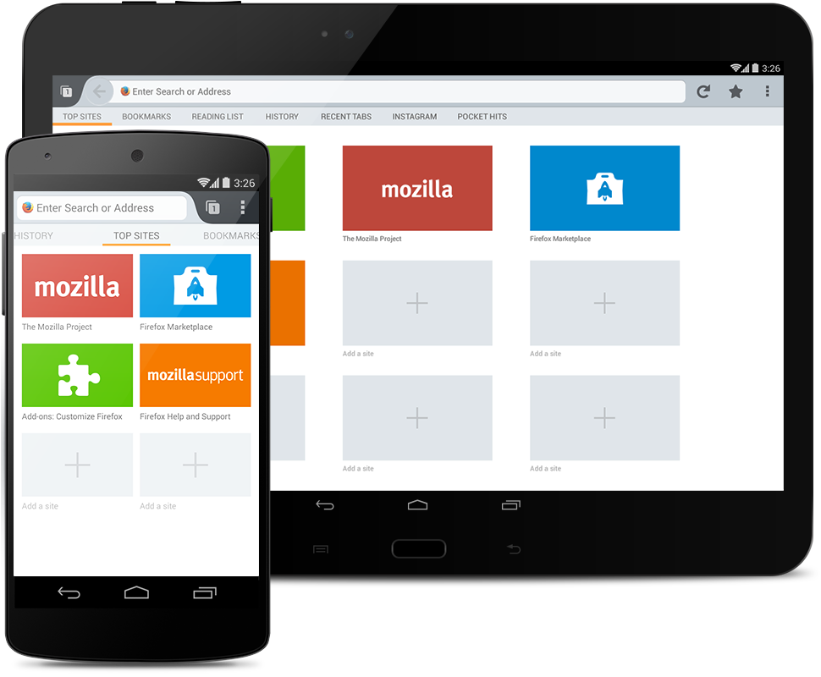

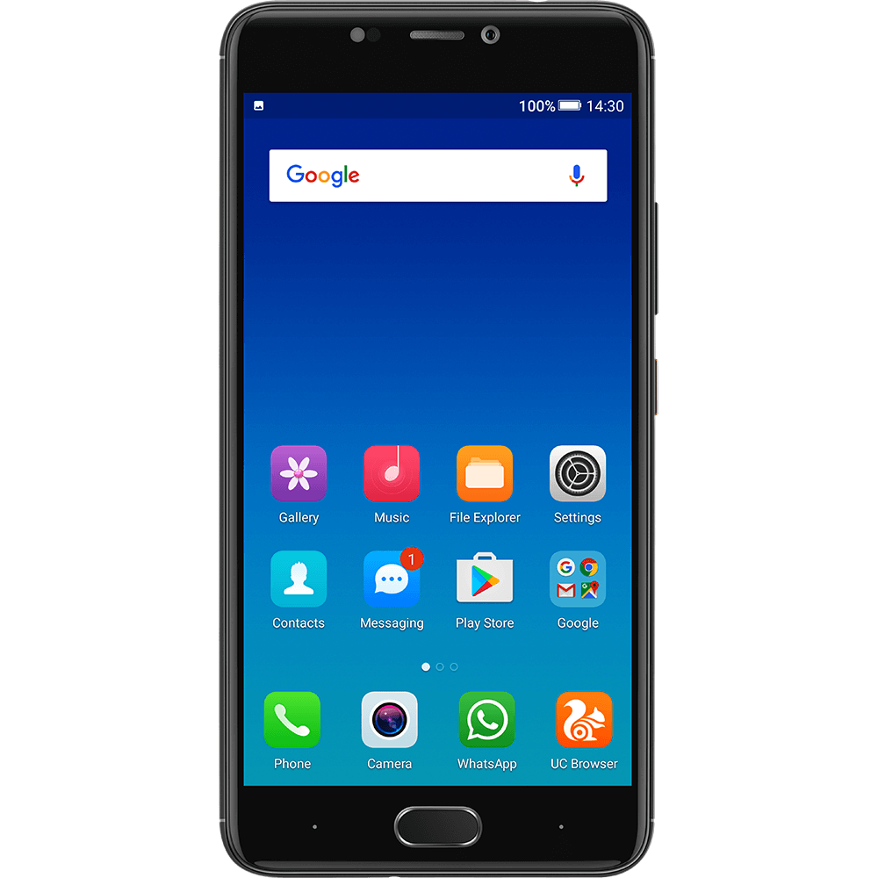
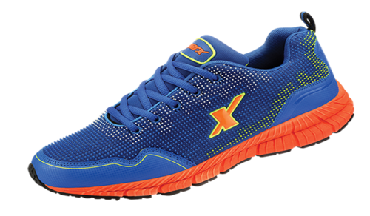
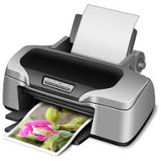
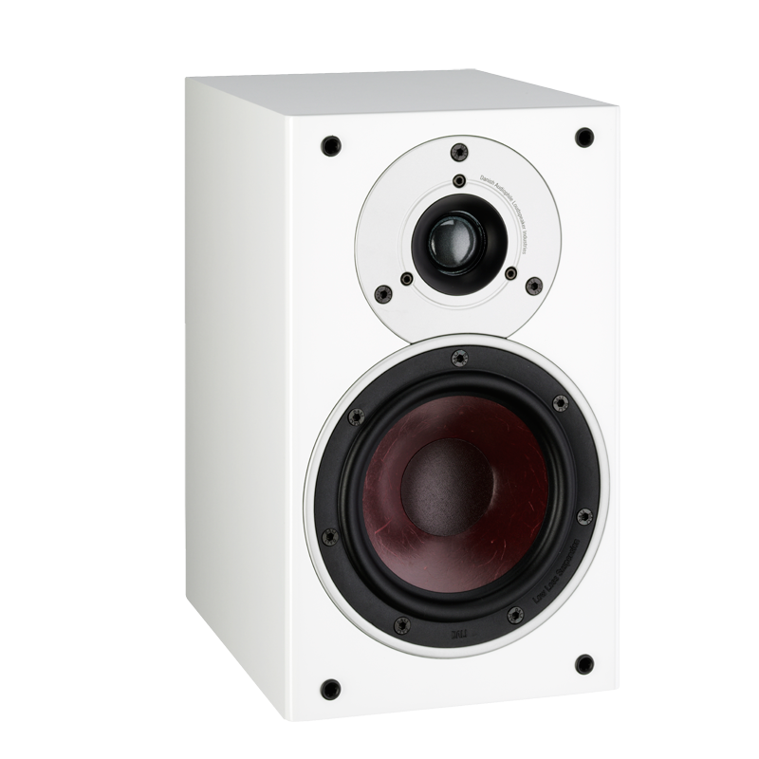
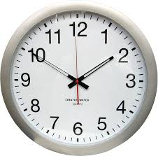
What are you looking for ?
Your Account
Orders
4
Cart
Profile Details
Your Previous Purchase
HP 64 XL High Yield Black
HP 64 XL Cartridge
Fits like the standard cartridge
Up to 600 pages
Fits like the standard cartridge
Up to 600 pages
$200.00
$200.00
Nokia Mobile 5500
Dell Laptop
Kevin Molloy
Fits like the standard cartridge
Up to 600 pages
Fits like the standard cartridge
Up to 600 pages
Product Strategy Head Life Sciences
$200.00
$200.00
Your recently viewed items and featured recommendations
Nokia 6060
Puma
HP printer
boAt speaker
Wall clock
$200.00
$200.00
$200.00
$200.00
$200.00

Slide 2

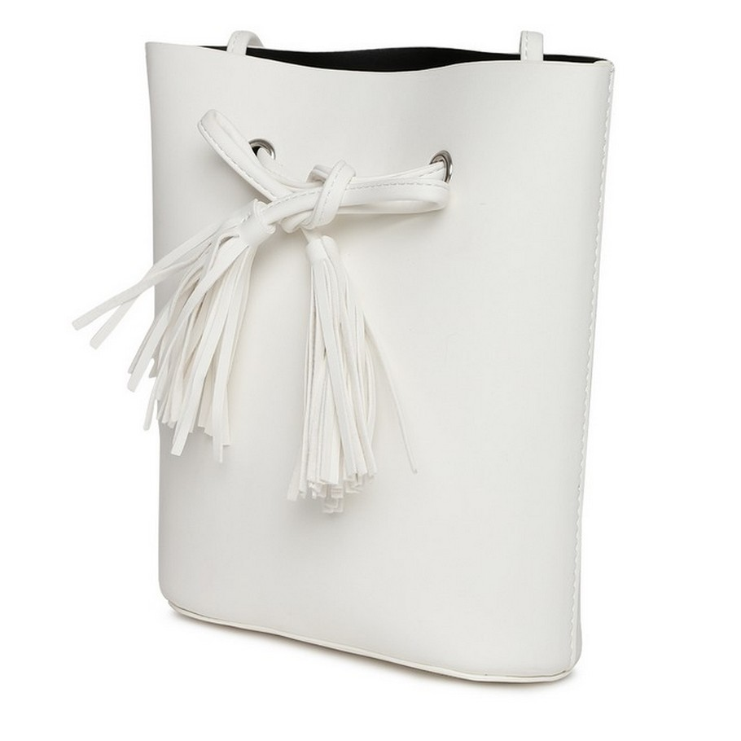





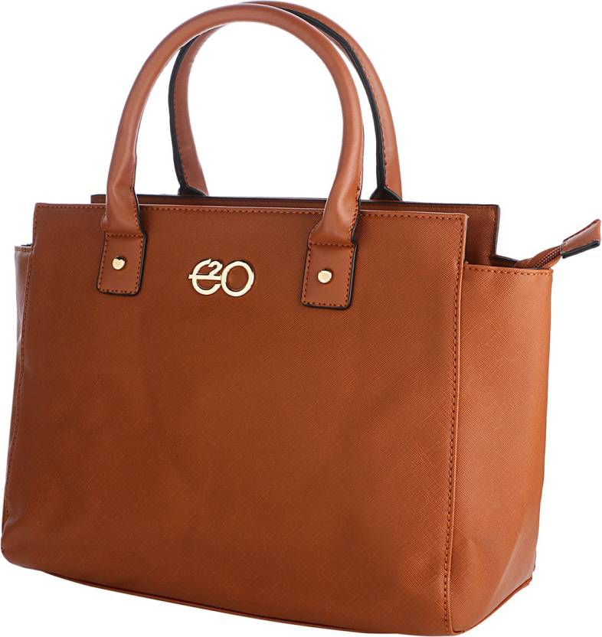





Hello there, Brian!!
Welcome to
Personalized Offers
Know Your Store
Tassel Sling Bag
$80
$64
Self Design Top
$45 $40.5
E2o Tan Sachet Handbag
$40
$36.4
Irvin Adams
Store Associate
Next

Slide 3



Hello there, Brian!!
Welcome to
Know Your Store
Offers on Breakfast cereals and grocery
$3.64
Self Design Top
$3.39
E2o Tan Sachet Handbag
$2.50
Irvin Adams
Store Associate
Next

Slide 4
Your previous Store Assistant:
Anand
Ping

Slide 6
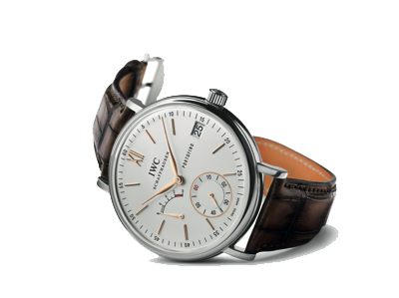
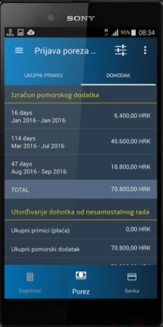

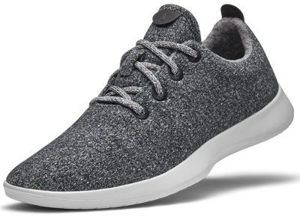
Welcome to
New Arrivals
Know Your Store
IWC-Formal Watch
Sony C6
$3500.00
$450.00
PAC- Original OS
Running Shoe
$150.00
$150.00
Associate Name
Store Associate
See more

Slide 7
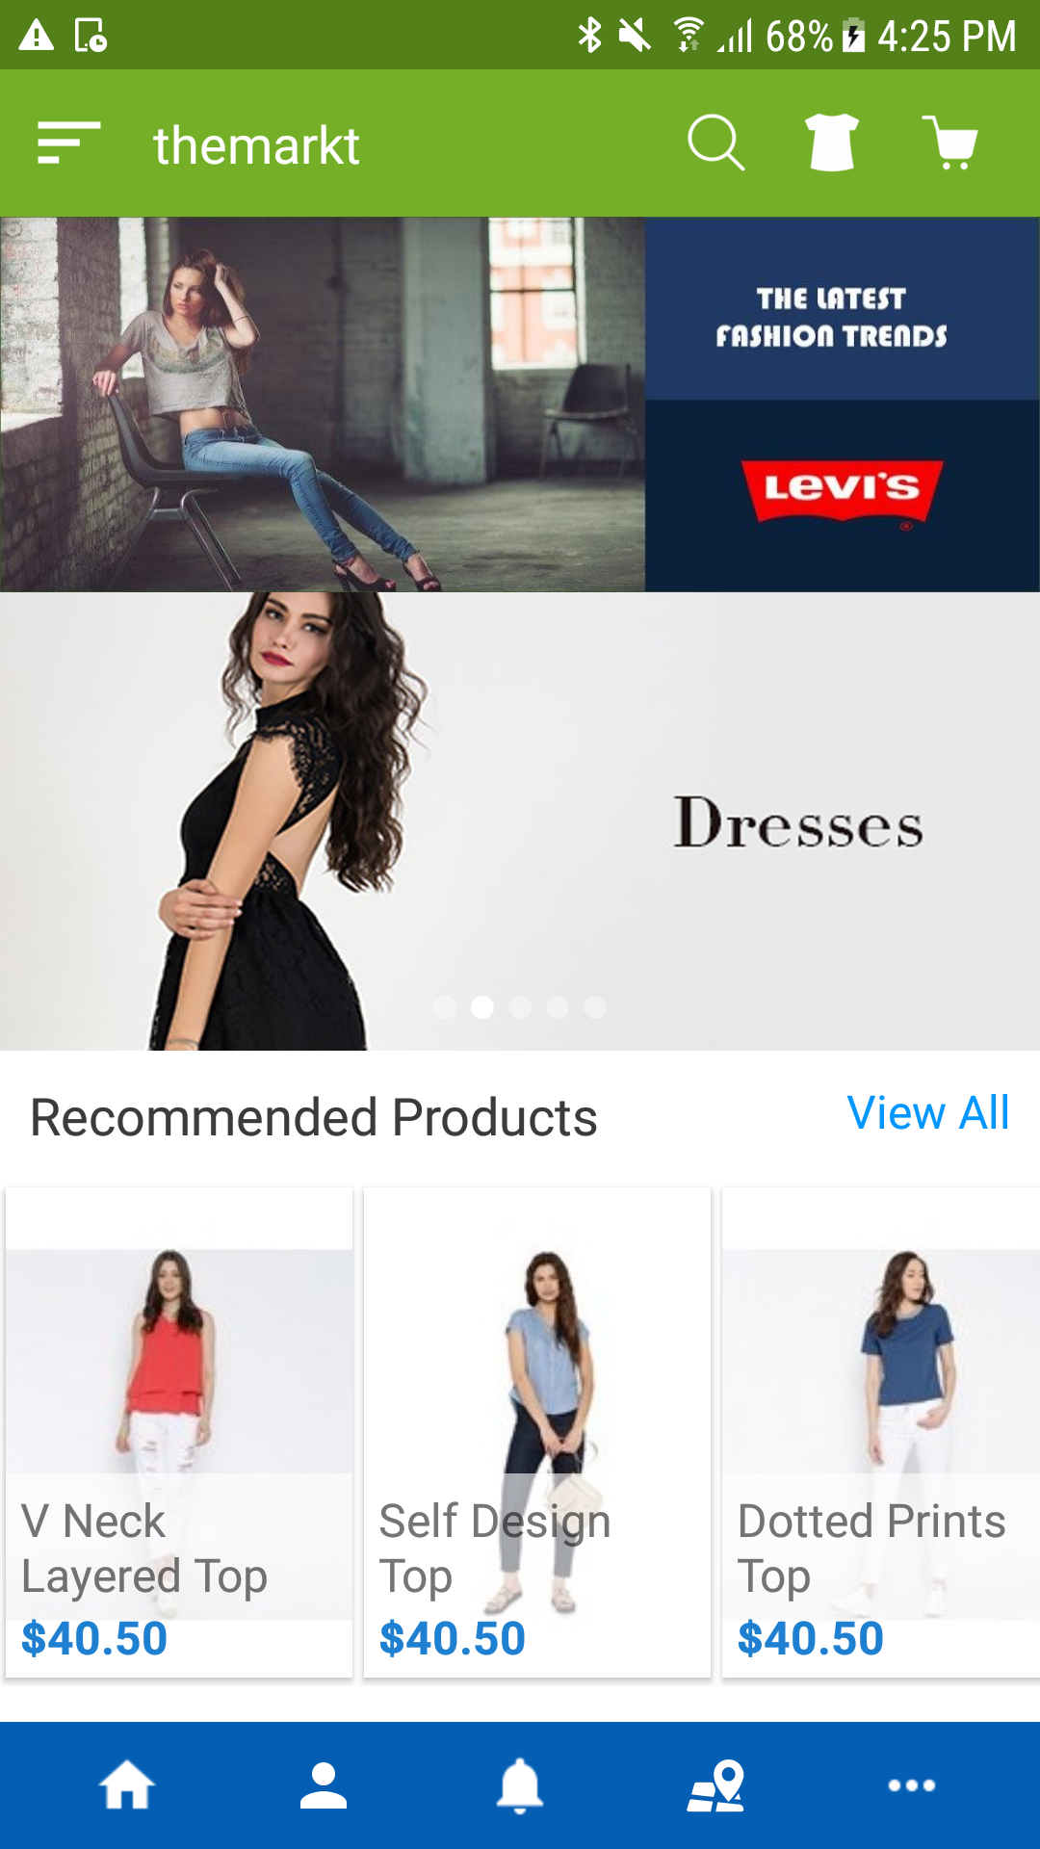
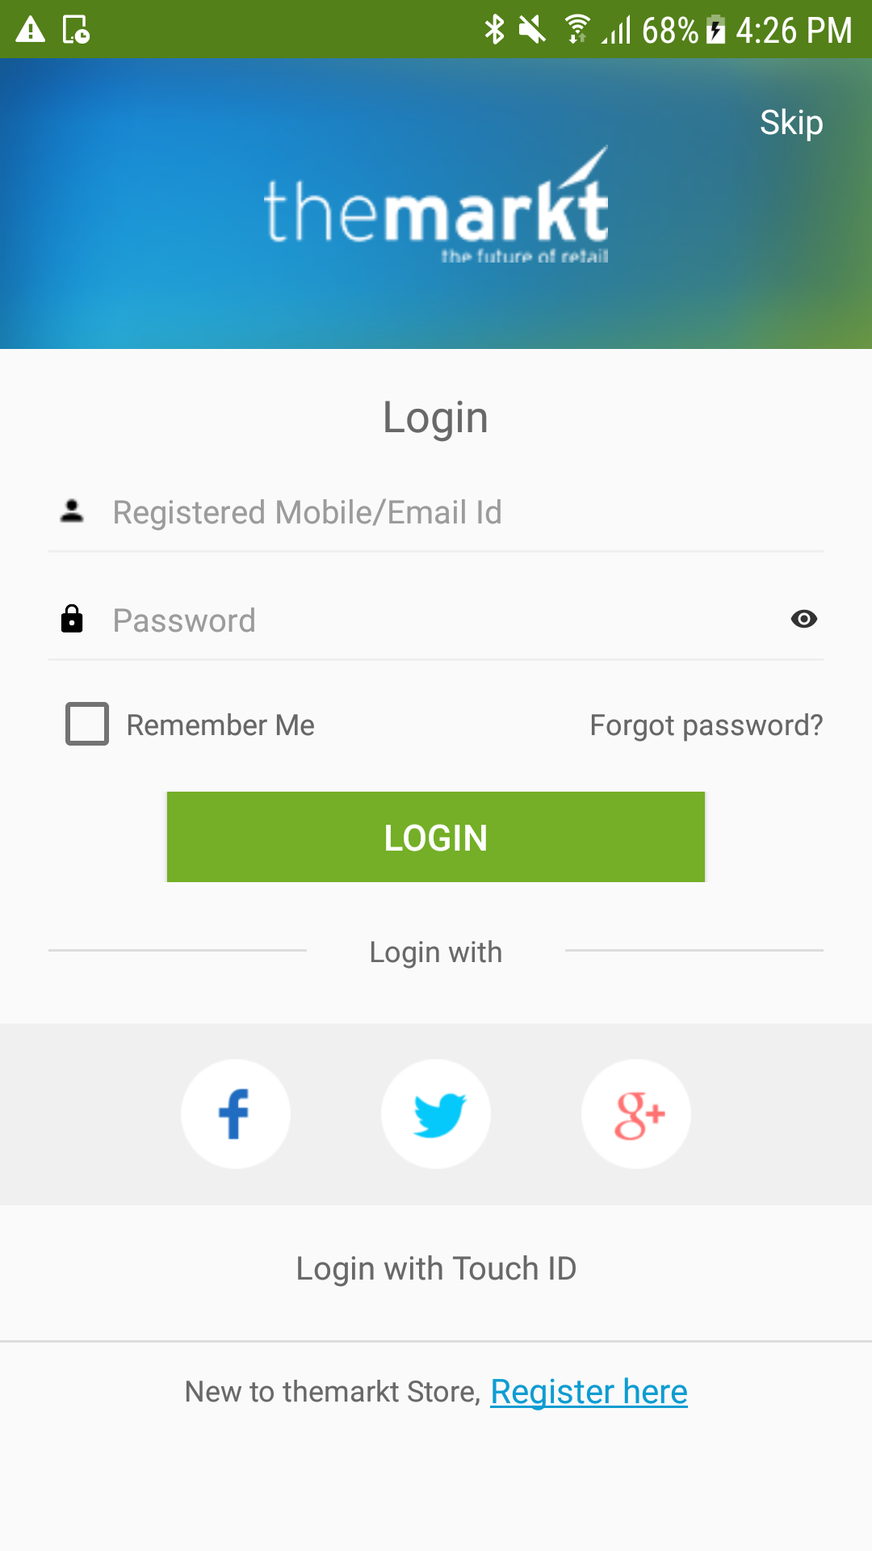




To unlock more exciting offers at
our Online and Offline stores,
Download our the markt app.

Slide 8



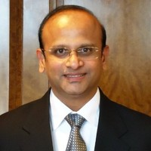


Your Shoppers in Store Today
Sorted by Customer
Loyalty scores
First Time Visitors
Profile Details
Brian Humphries
Velu
Palvasha
MVP of the month!
Ganesh
Sanjay
Loyalty Score : 175
Last Visit: 14th Mar ‘19
See more

Slide 9

What are you looking for ?
Your Account
Orders
4
Cart
Profile Details
Your Previous Purchase
HP 64 XL High Yield Black
HP 64 XL Cartridge
Fits like the standard cartridge
Up to 600 pages
Fits like the standard cartridge
Up to 600 pages
$200.00
$200.00
Nokia Mobile 5500
Dell Laptop
Kevin Molloy
Fits like the standard cartridge
Up to 600 pages
Fits like the standard cartridge
Up to 600 pages
Product Strategy Head Life Sciences
$200.00
$200.00
Your recently viewed items and featured recommendations
Nokia 6060
Puma
HP printer
boAt speaker
Wall clock
$200.00
$200.00
$200.00
$200.00
$200.00

Slide 10


Hello there, Palvasha!!
Welcome to
Profile Details
Pers
Recommendations
Based on your last purchase
Hp Printer-White
Hp Printer-Cartridge
$350.00
$50.00
$30.00
Hp Printer- Papers
Many compatible products with handpicked offers especially for you.!
$50.00
$25.00
Brian Humphries
See more

Slide 11
Hello there, Brian!!
Welcome to
Profile Details
Offers on your First purchase
Exclusively for our first time shoppers.
Puma
Nokia 6060
$200.00
$200.00
boAt speaker
Dell Laptop
$200.00
$200.00
Brian Hamphries

